Slide 1
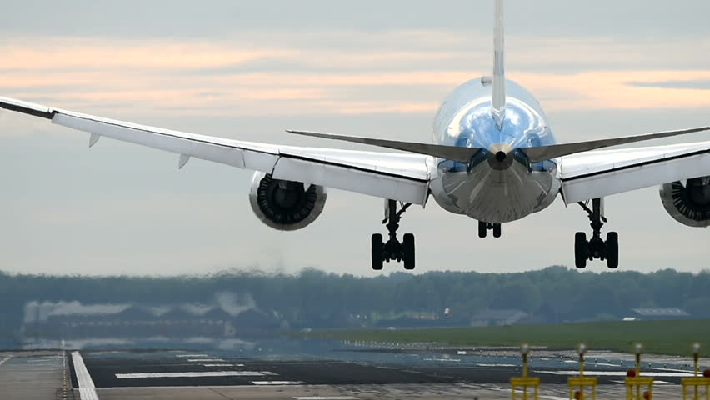
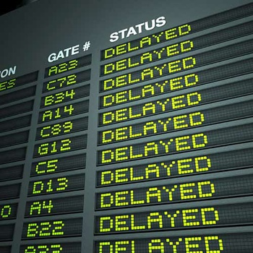
FLIGHT ARRIVAL DELAY PREDICTION
ALAIN LEUKAM
FLATIRON SCHOOL 2020
INSTRUCTOR: ABHINEET KULKARNI

Slide 2
INTRODUCTION
What are the factors that could contribute to flight arrival delay?
Out of those factors which one is the biggest contributor?
Which airline company appears to be the one with the most arrival delays.

Slide 3
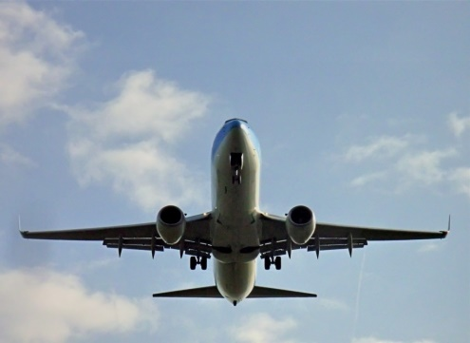
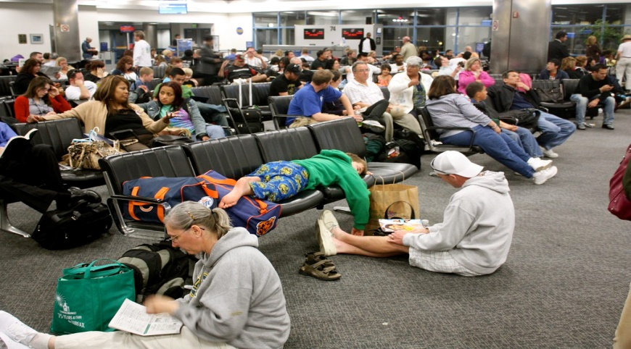
METHODOLOGY
Data Cleaning
Descriptive analysis
Feature Selection
Model Selection
Tuning Training testing

Slide 4
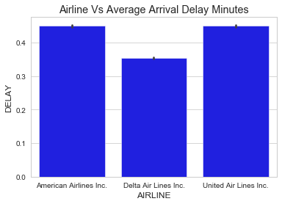
DeSCRIPTIVE ANALYSIS
Our model was built base on three airlines as advised by the instructor; Delta airline has the lowest average delay as indicated on the graph below:

Slide 5
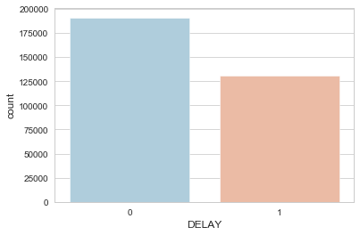
DeSCRIPTIVE ANALYSIS
191015 flights in our data are without arrival delays
131030 flights have arrival delays
Base on the number above almost 41% of flights in our data have delays

Slide 6
Feature's SELECTION
We initially hand pick 5 features with high impact on the arrival delay:
Late aircraft delay
Airline delay
Air system delay
Weather delay
Elapsed time

Slide 7
Feature's SELECTION
We added more features based on their weight on the arrival delay: we added 10 more features to increase to number of feature to 15.

Slide 8

model selection: three of them tried
DecisionRegressor
BaggingRegressor
RandomForestRegressor

Slide 9
Tuning Training testing
Out of the three models tried, random forest was more accurate in predicting the arrival delay. This model was selected to tune, train and test our data.

Slide 10
Conclusion
Our model was fairly accurate predicting arrival delay with an error of 0.075 minute; but when a flight without departure delay was tested we didn’t have the same accuracy.
It is worth noting that we can use our model to compare historical delay amount airline companies and be able to advise customer on the best airlines to take if you want to avoid Arrival delay.
For future work, we may study the impact of model where the departure delay is drop.
Given the fact that more arrival delays are caused by departure delays, the flights with arrival delays without departure delays will be considered as outliers and our models will be able to predict the arrival delays.

